Slide 1
Mahendra Singh Dhoni: The Captain, The Legend, The Legacy
A Presentation on Mahendra Singh Dhoni

Slide 2
Overview: Exploring the Journey of MSD
Unpacking the multifaceted career of one of India's most celebrated cricketers.
Highlighting his unique prowess as a right-handed batter and exceptional wicket-keeper.
Delving into his unparalleled captaincy record and leadership in limited-overs formats.
Showcasing his significant contributions to India's ICC title victories.
Recognizing his iconic status with the Chennai Super Kings in the Indian Premier League.

Slide 3
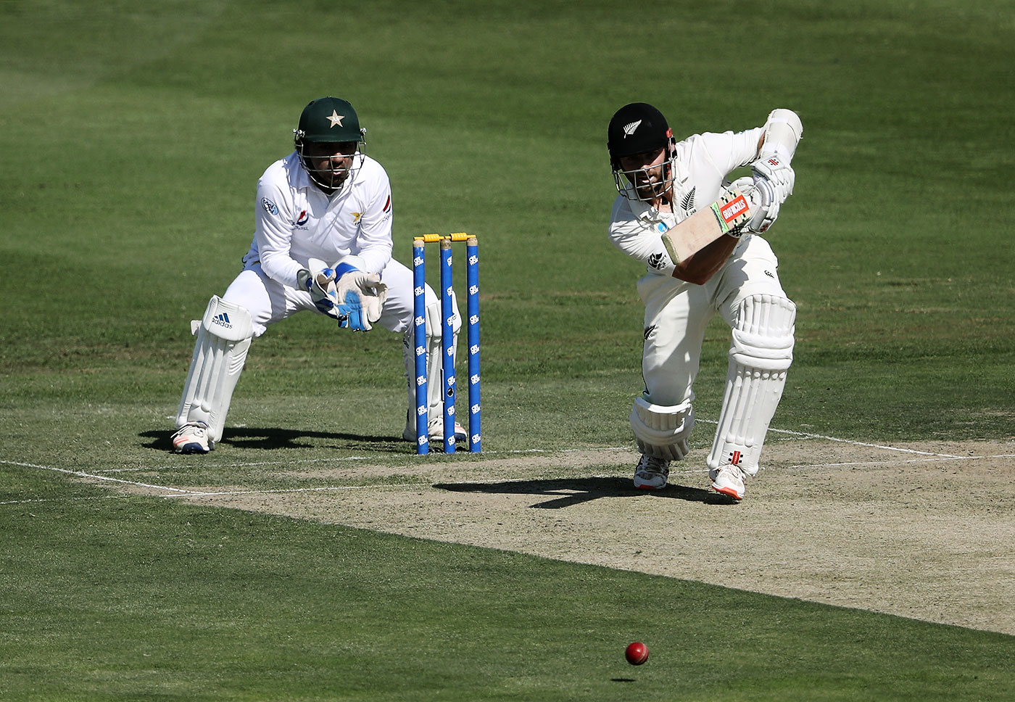
The Prolific Wicket-Keeper Batsman
Mahendra Singh Dhoni is renowned as a highly prolific right-handed batter.
He played a pivotal role as a wicket-keeper, redefining the position with his skills.
Widely regarded as one of the greatest One-Day International (ODI) batsmen in cricket history.
His distinctive finishing style and calm approach under pressure set him apart.

Slide 4

India's Most Successful Captain
Dhoni captained the Indian team in limited-overs formats, leading them to historic success.
He holds the record for captaining the most international matches for India.
Acknowledged as the most successful Indian captain due to his strategic acumen and results.
His calm demeanor, self-belief, and ability to make tough decisions were hallmarks of his leadership.

Slide 5
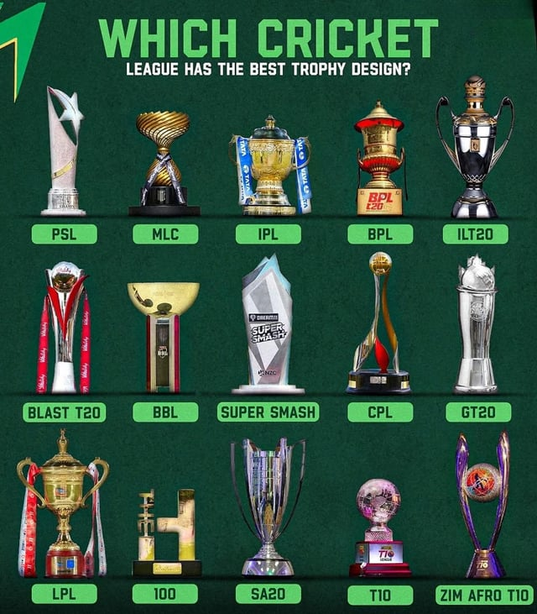
Architect of ICC Triumphs
MS Dhoni led India to three significant ICC titles during his captaincy tenure.
A monumental achievement was guiding India to victory in the 2007 ICC World Twenty20.
His leadership brought major global cricketing silverware to the nation.
These victories cemented his legacy as a captain who consistently delivered on the grandest stages.

Slide 6
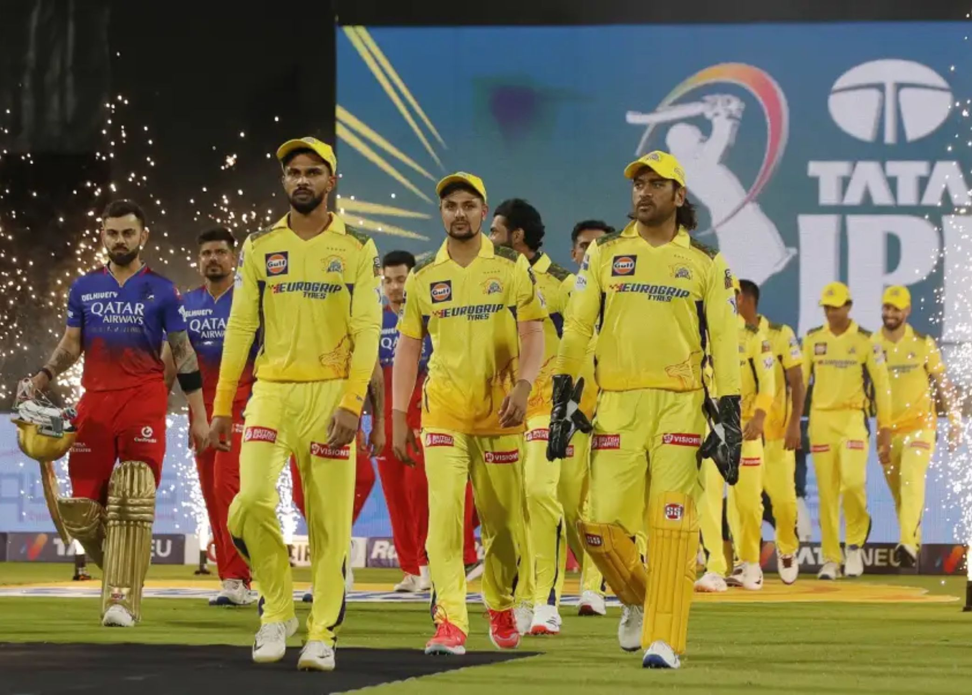
The Icon of Chennai Super Kings
Beyond international cricket, Dhoni is equally celebrated for his exploits in the Indian Premier League (IPL).
He is famously associated with the Chennai Super Kings (CSK), donning their iconic yellow jersey.
His captaincy transformed CSK into one of the most successful and beloved franchises in IPL history.
His unwavering dedication and strategic brilliance made him a fan favorite and a T20 legend.

Slide 7
The Enduring Legacy of MSD
Mahendra Singh Dhoni's career epitomizes cricketing excellence, leadership, and unwavering composure.
He left an indelible mark as a game-changer, both with his bat and behind the stumps.
His captaincy era is remembered for pioneering success and instilling a winning mentality in Indian cricket.
Dhoni's calm leadership and ability to perform under pressure continue to inspire generations of cricketers and fans.
He remains a revered figure, celebrated for his unparalleled contributions to both national and franchise cricket.

